Slide 1

Cardiovascular disease: Stroke prediction By Jimmy Mubalutila

Slide 2
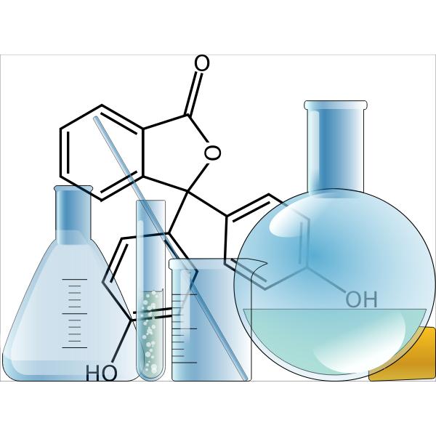
About ME
Born in the Democratic Republic of Congo and grew up speaking multiple languages but English
Migrated in the United States as an international student
Chemistry as a major study
Pharmaceutical industry as a professional career
Married and father of 3 adorable kids
Hobbies
Soccer player, basketball, running tracks
Video gaming
Fun time with family and traveling

Slide 3

Medical diagnostic: are you a subject at risk?
Blood pressure spiked high
Bmi out of control
Bad cholesterol level on the rise
Glucose level borderline
Weight gained
Recommendation:
Weight control
Diet: DASH
Less to no alcohol consumption

Slide 4
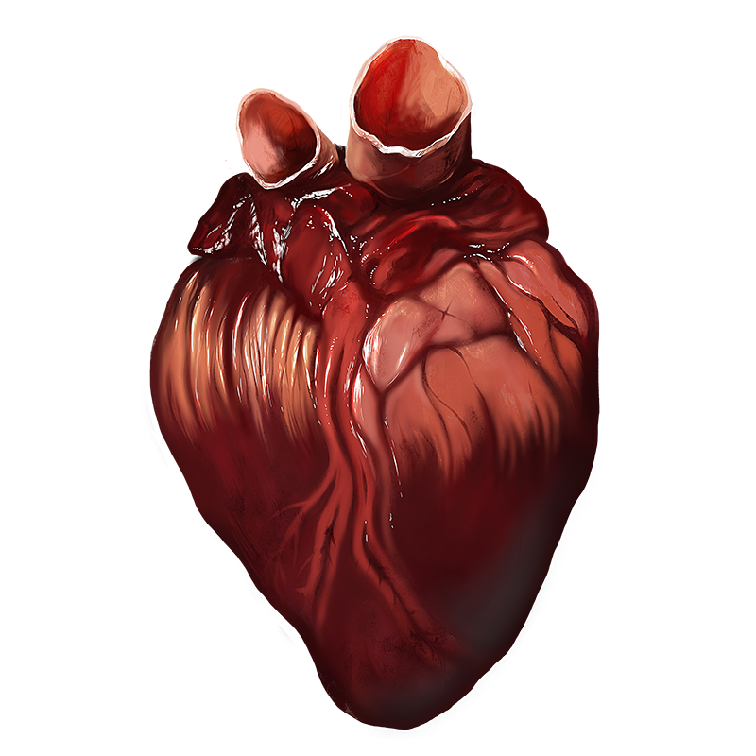
BACKGROUND INTRODUCTION
Cardiovascular disease are conditions that affect the structure and functions of the heart.
The most common types of cardiovascular disease are:
Coronary artery disease (damage in the heart’s major blood vessels)
High blood pressure (a condition in which the force of the blood against the artery walls is too high)
Cardiac arrest (unexpected loss of heart function, breathing and consciousness)
Congestive heart failure (A chronic condition in which the heart doesn’t pump blood as well as it should)
Stroke (damage to the brain from interruption of its blood supply)
This Photo by Unknown Author is licensed under CC BY-SA-NC

Slide 5

Heart disease facts
From the Center for Disease Control and Prevention, cardiovascular disease is the leading cause of death in the US for men and women of all ethnic groups.
One person dies every 36 seconds in the United States from cardiovascular disease
About 659,000 people in the United States die from heart disease each year
The cost of healthcare services, medicines and lost of productivity due to heart disease death cost the United States an estimated $363 billion each year
This Photo by Unknown Author is licensed under CC BY-NC-ND

Slide 6


Are cardiovascular diseases preventable?

Slide 7

Machine learning and stroke prediction
This Photo by Unknown Author is licensed under CC BY

Slide 8
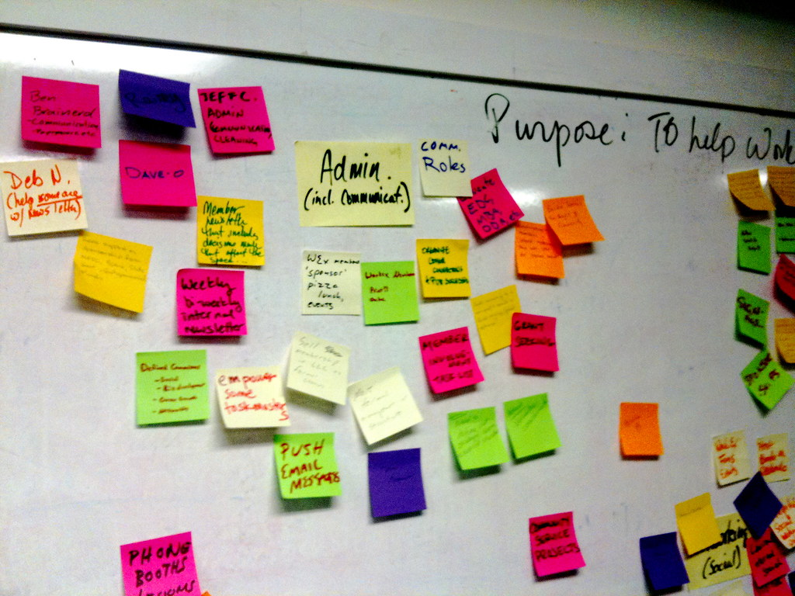

Method
Kaggle dataset used to conduct the study: Stroke Prediction Dataset (11 clinical features for predicting stroke events)
https://www.kaggle.com/fedesoriano/stroke-prediction-dataset/version/1
Data wrangling
Data visualization
Exploratory analysis
Single decision tree
Random forest
This Photo by Unknown Author is licensed under CC BY

Slide 9

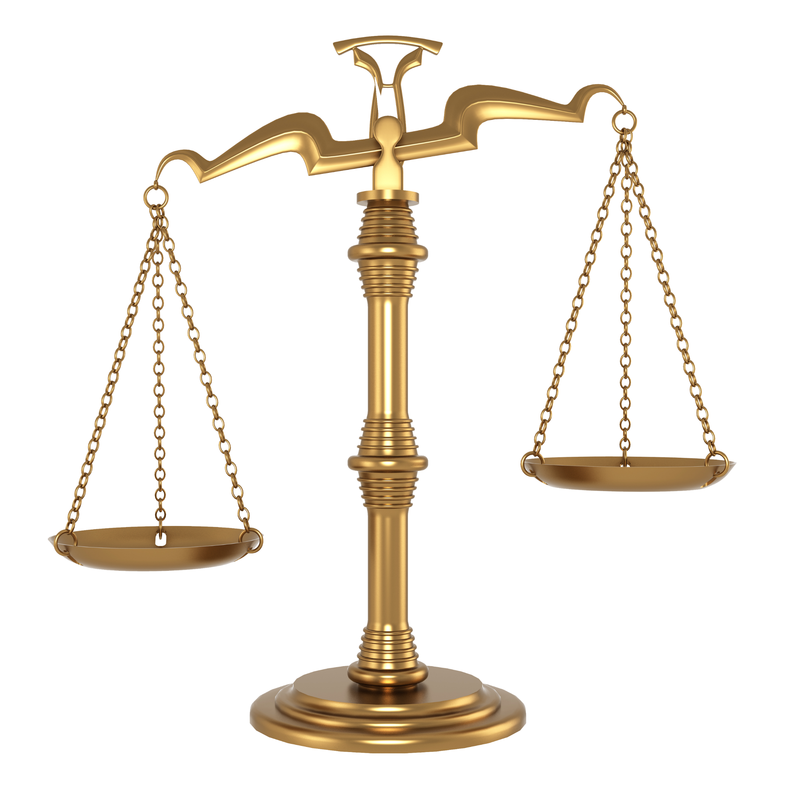
Concern with datasets
Data features are imbalanced:
Imbalance classification, also called rare event modeling, occurs when the target label for a classification modeling dataset is highly imbalanced. We call the minority event to be a rare event. In this case, the model tends to get learnings from the majority class and predicting the minority class can be challenging.
This Photo by Unknown Author is licensed under CC BY-NC
This Photo by Unknown Author is licensed under CC BY-NC

Slide 10
Method used to balance features
Random Under-Sampling: Random under-sampling randomly picks data point from the majority class. After the sampling is processed, the majority class has the same number of data points as the minority class.
Random Oversampling: Random oversampling involves randomly selecting examples from the minority class, with replacement, and adding them to the training dataset. Random oversampling was processed using BalancedBaggingClassifier, which does not balance each subset of data, but will instead favor the majority classes and create a biased model.
SMOTE: SMOTE (synthetic minority over sampling technique) oversampling: instead of randomly oversampling with replacement, SMOTE takes each minority sample and introduces synthetic data point connecting the minority sample with its nearest neighbors. Neighbors from the k nearest neighbor are chosen randomly.

Slide 11
Reporting

